Slide 1
Relational inductive biases, deep learning, and graph networks
Peter W. Battaglia¹, Jessica B. Hamrick¹, Victor Bapst¹, Alvaro Sanchez-Gonzalez¹, Vinicius Zambaldi¹, Mateusz Malinowski¹, Andrea Tacchetti¹, David Raposo¹, Adam Santoro¹, Ryan Faulkner¹, Caglar Gulcehre¹, Francis Song¹, Andrew Ballard¹, Justin Gilmer², George Dahl², Ashish Vaswani², Kelsey Allen³, Charles Nash⁴, Victoria Langston¹, Chris Dyer¹, Nicolas Heess¹, Daan Wierstra¹, Pushmeet Kohli¹, Matt Botvinick¹, Oriol Vinyals¹, Yujia Li¹, Razvan Pascanu¹
¹DeepMind; ²Google Brain; ³MIT; ⁴University of Edinburgh
GNN Study Group, Jan 19th 2020

Slide 2








We’re hiring!
Oct. 2018 - now
Wei-Hsiang (Matt) Wang
AI Engineer, Umbo CV
Feb. 2018 ~ Sept. 2018
Coordinator & speaker, Pytorch Taipei
July 2016 - Aug. 2018
M.S., Mechanical Eng., NTU
Sept. 2012 - June 2016
B.S., Mechanical Eng., NTU

Slide 3
SECTION 1 INTRODUCTION

Slide 4

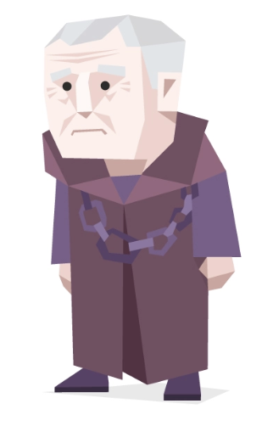
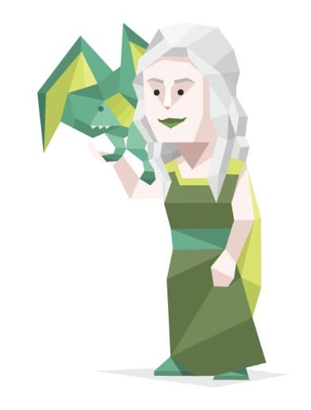
“part position paper, part review, and part unification”
Position paper Enables discussion on emerging topics without the experimentation
Review Surveys and summarizes previously published studies
Unification Makes different logical expressions identical by finding a substitution
https://dribbble.com/zedalabs/projects/240402-16-Personalities https://en.wikipedia.org/wiki/Review_article https://en.wikipedia.org/wiki/Position_paper
Notes:
Position paper: simply GN good, current DL bad
Review paper:
unification: unify the “hand-engineering” & “end-to-end learning”

Slide 5
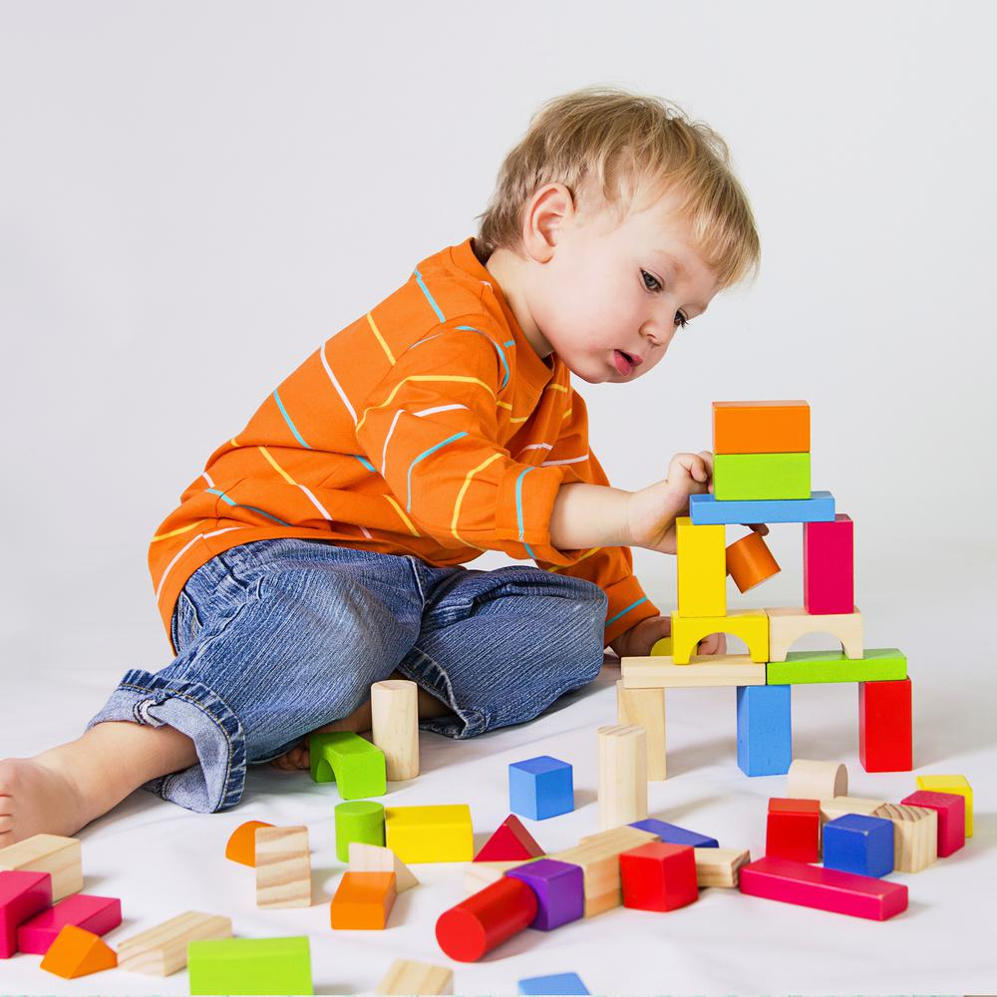

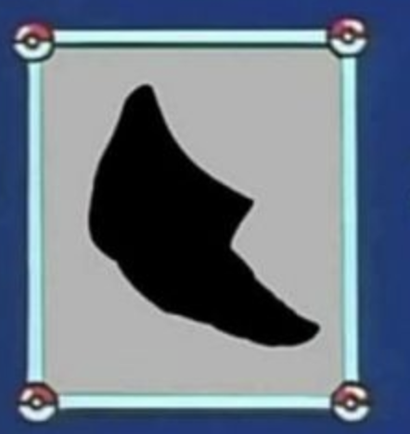
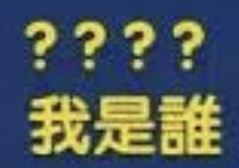


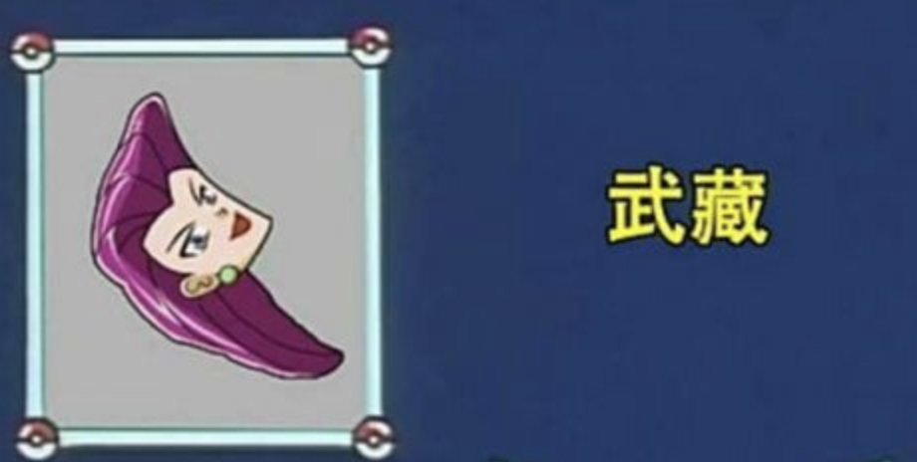
Combinatorial Generalization
“Constructing new inferences, predictions, and behaviors from known building blocks”
“The world is compositional, or at least, we understand it in compositional terms”
https://www.dcard.tw/f/funny/p/224542090
Notes:
human make infinite use of finite means → current DL is weak
Combinatorial Generalization must be a top priority for AI to achieve human-like abilities

Slide 6
Current DL model design trends
What do most current DL models do?
Minimal a priori representational and computational assumptions
Seeks to avoid explicit structure and “hand-engineering”
Trading off sample efficiency for more flexible learning
Weakness of most trending DL mdoels:
Reasoning about structured data
Transferring learning beyond the training conditions
Learning from small amounts of experience
Notes:
do: (1+2) end-to-end model (3)cheap data and cheap computing resource
weak: (2) train on 1st order system → cannot apply on multi-ordered system, weak ability to generalize (3) few-shot

Slide 7
The goal of this paper
Advocate the synthesizing structure-based methods & DL
“To achieve capacity for performing computation over discrete entities and the relations between them”
Introduce Graph Network
“Generalizes and extends various approaches for neural networks that operate on graphs, and provides a straightforward interface for manipulating structured knowledge and producing structured behaviors.”
Notes:
DL pioneers who faced the challenge -> find structure-based methods
carry strong relational inductive biases, in the form of specific architectural assumptions, which guide these approaches towards learning about entities and relations

Slide 8
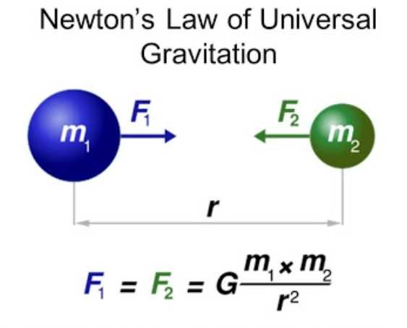
Relational Reasoning
Structure: The product composes a set of known building blocks
Entity: An element with attributes
Relation: The property between entities
Rule: A function maps entities and relations to other entities and relations

Slide 9
SECTION 2 Relational Inductive Bias

Slide 10
Inductive Bias
“An inductive bias allows a learning algorithm to prioritize one solution (or interpretation) over another, independent of the observed data”
What is Inductive Bias?
The assumptions made by the model to learn the target function and to generalize beyond training data
Examples
linear regression → relationship between the attributes x and the output y is linear
linear SVM → Input data is linear separable
NN with backprop → Smooth interpolation between data points
https://stackoverflow.com/questions/35655267/what-is-inductive-bias-in-machine-learning/55200993
http://axon.cs.byu.edu/~martinez/classes/478/slides/Bias.pdf
http://www.lauradhamilton.com/inductive-biases-various-machine-learning-algorithms

Slide 11
Relational Inductive Bias
“Inductive biases which impose constraints on relationships and interactions among entities in a learning process”
Notes:
Analysize method

Slide 12
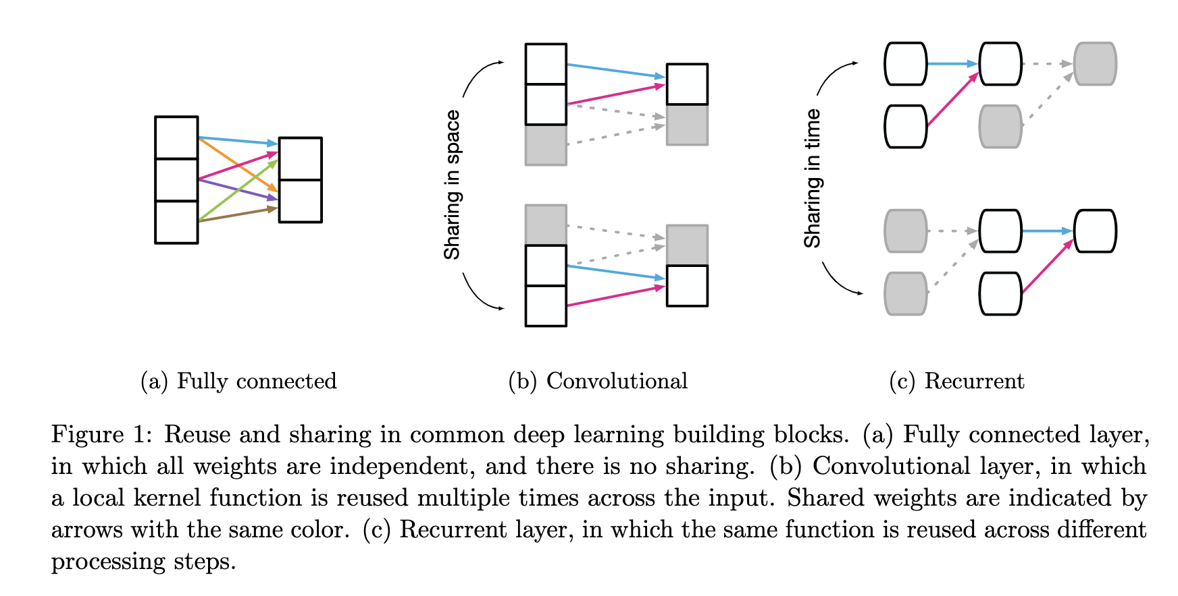
Current DL design practice

Slide 13
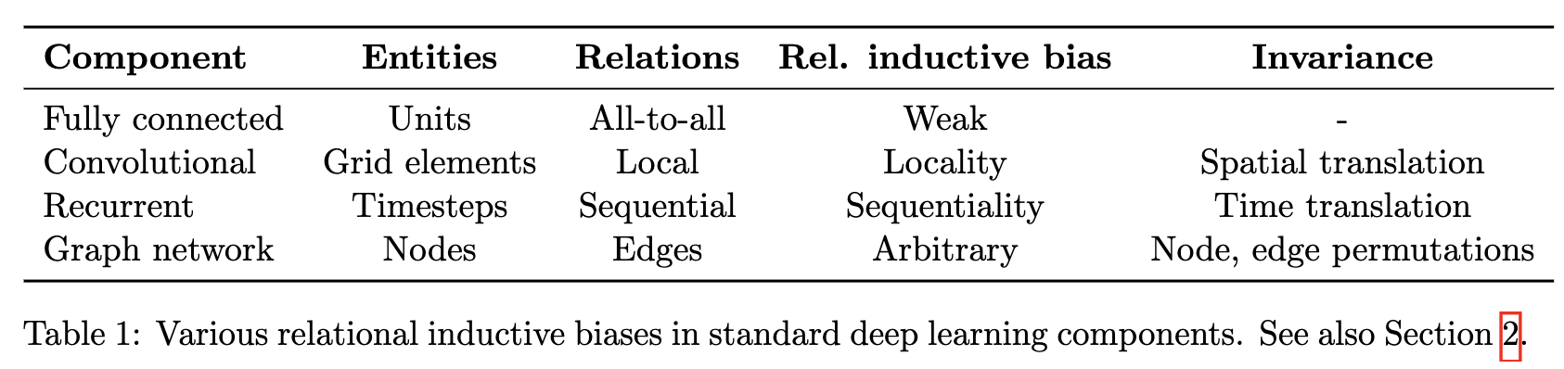
Current DL design practice

Slide 14
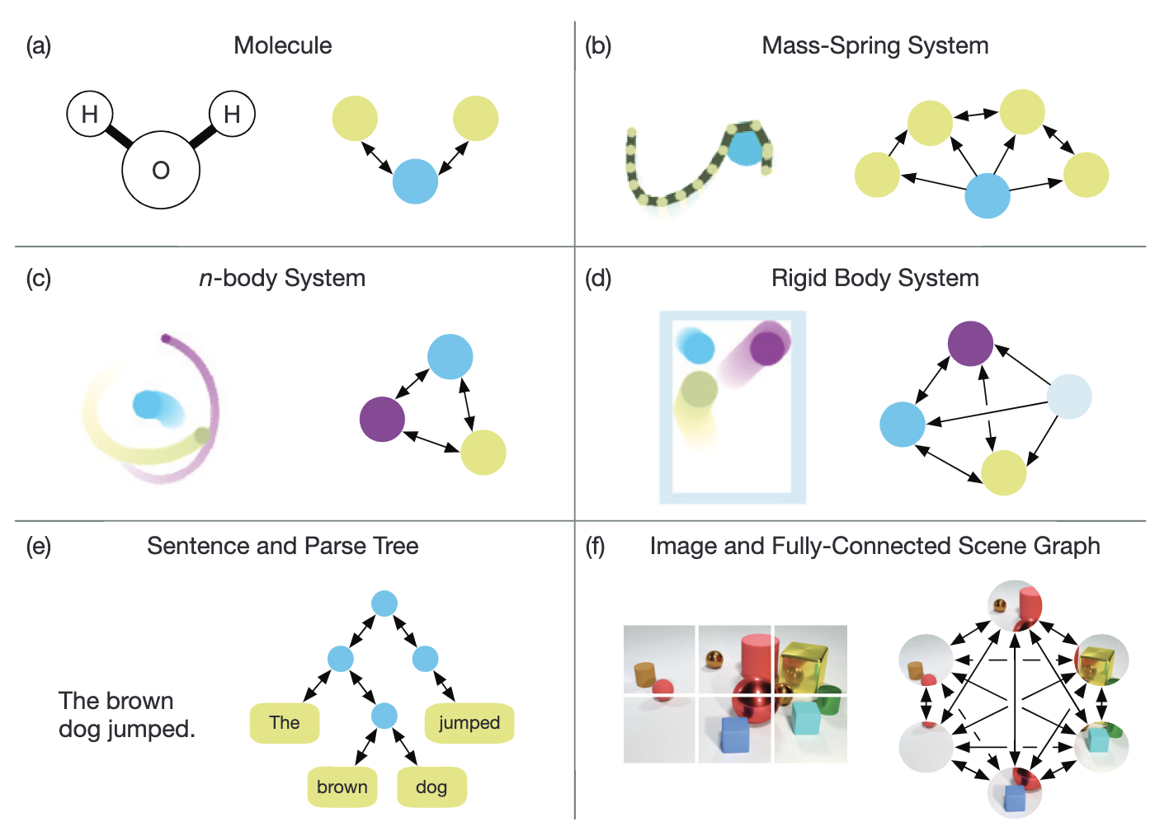
Computations over sets and graphs

Slide 15
SECTION 3 Graph Networks

Slide 16
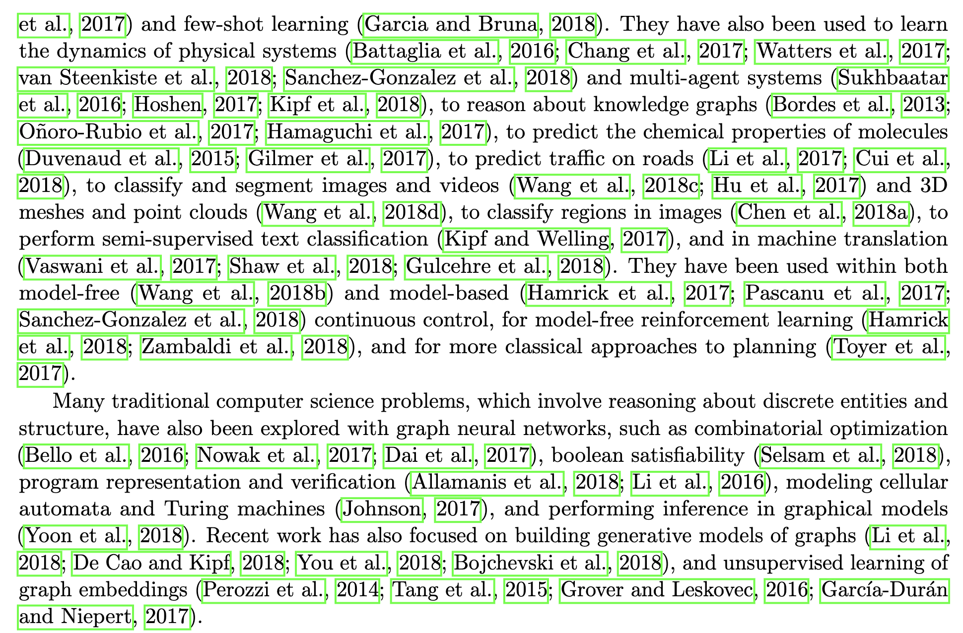
Many References!
and i won’t go through any of them (:troll_face:)

Slide 17

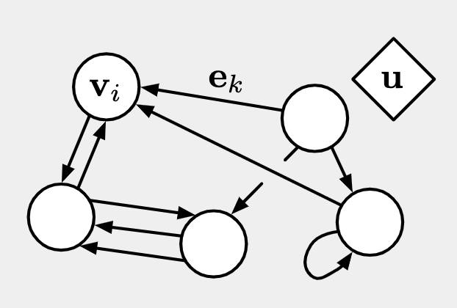
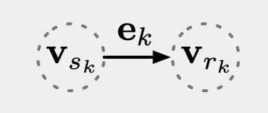
Definition of Graph
Node (entity)
Edge (relation)
Global Attribute (system properties)
For an edge
Sender node
Receiver node
Notes:
planet system:
v → planet
e → distance, force
u → net force, net potenial energy (=0)

Slide 18
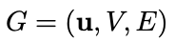
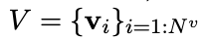
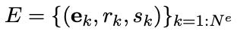
Definition of Graph
A graph G can be denoted as
where V denotes the set of nodes
and E denotes the set of edges
Notes:
planet system:
v → planet
e → distance, force
u → net force, net potenial energy (=0)

Slide 19

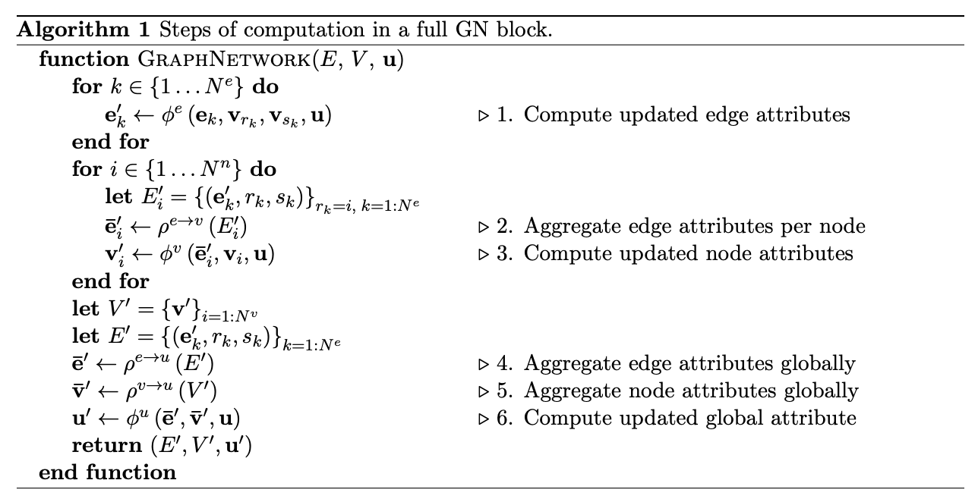
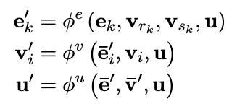
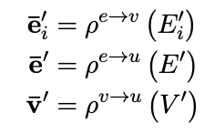
Graph network (GN) block
Takes in a Graph (E, V, u) and returns an updated Graph (E’, V’, u’)
Computaion over sets
Update Functions
Aggregation Functions
Notes:
Imagine a spring system
(phi)^{e}: calculate force or potential energy between masses
(rho)^{e→v}: sum the force or potential energy exerted on each mass
(phi)^{v}: update position, velocity, kenetic energy of a mass
(rho)^{e→u}: sum force (=0 based on newton’s 3rd law) or spring energy (of springs)
(rho)^{v→u}: Compute total kinect energy (of masses)
(phi)^{u}: compute total enery of the system

Slide 20
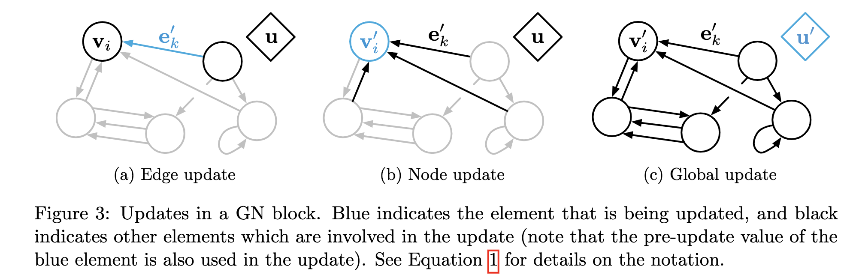
Graph network (GN) block
Notes:
Imagine a spring system
(phi)^{e}: calculate force or potential energy between masses
(rho)^{e→v}: sum the force or potential energy exerted on each mass
(phi)^{v}: update position, velocity, kenetic energy of a mass
(rho)^{e→u}: sum force (=0 based on newton’s 3rd law) or spring energy (of springs)
(rho)^{v→u}: Compute total kinect energy (of masses)
(phi)^{u}: compute total enery of the system

Slide 21
SECTION 4 Design Principles for GN Architecture
Flexible representations
Configurable within-block structure
Composable multi-block architectures

Slide 22
Flexible representations
Acept arbitrary format of attributes
Tensor (vector)
Sequences
Sets
Graphs
→ Returns list of tensors (vectors)
→ Allows GN output being passed to other DL blocks (MLP, CNN, RNN)
Input data represented as graph
If input is relational structured (e.g. social network, chemicals) → serve it
If not → transfer it or make assumption
e.g.:
Image → CNN feature map as node
Corpus → each word as node
→ or seperate learning process e.g.:
Infer entity from unstructured signal using MLP
.

Slide 23
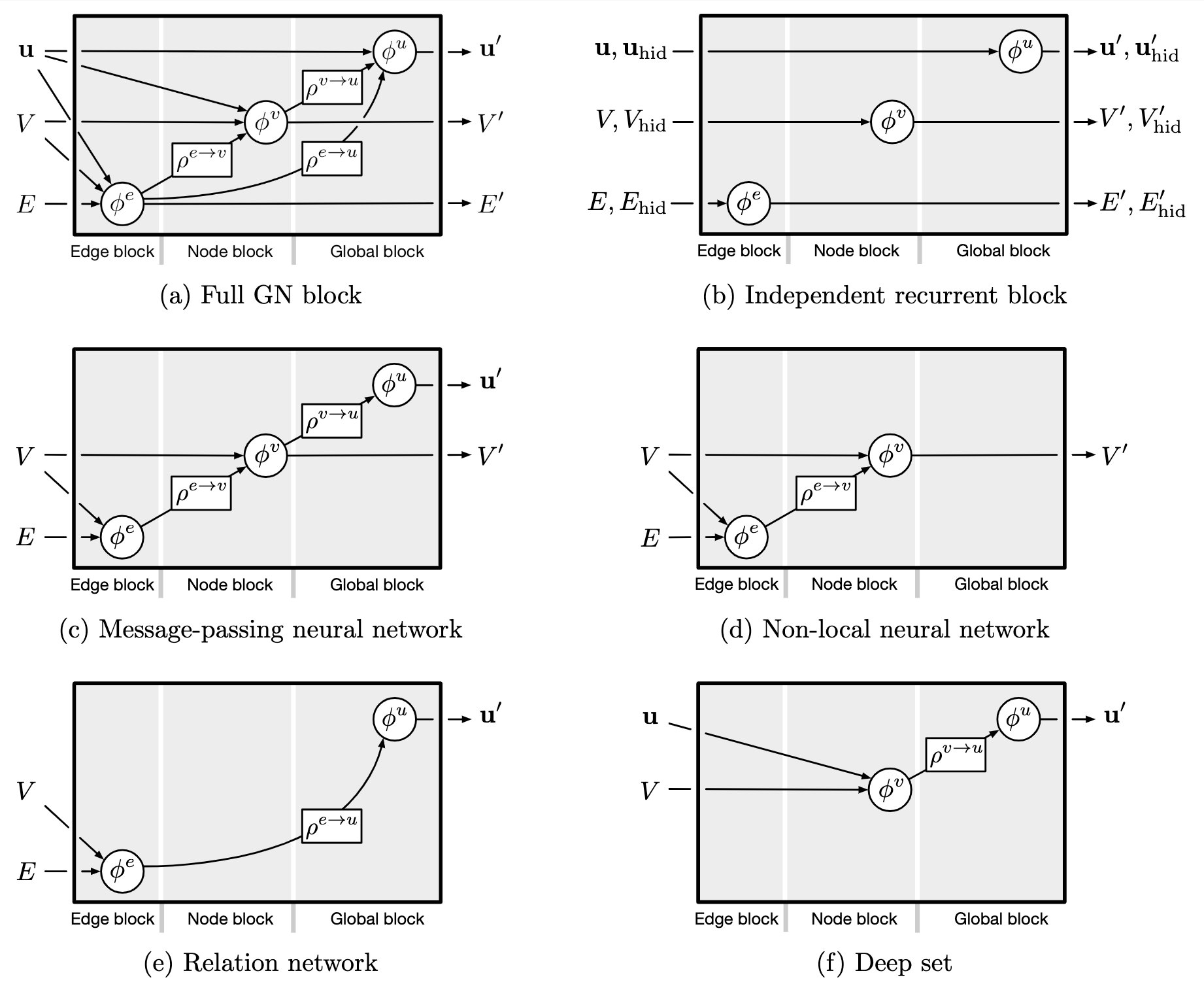
Configurable within-block structure

Slide 24
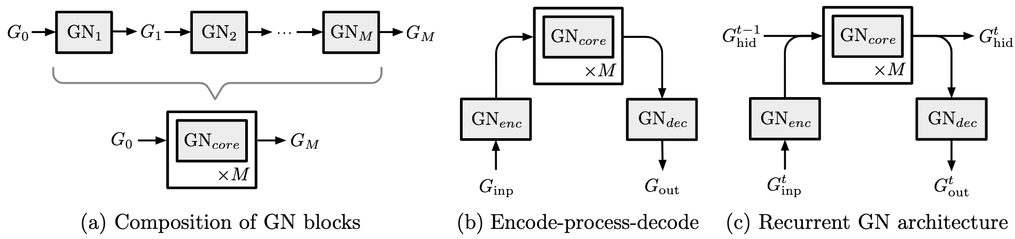
Composable multi-block architectures

Slide 25
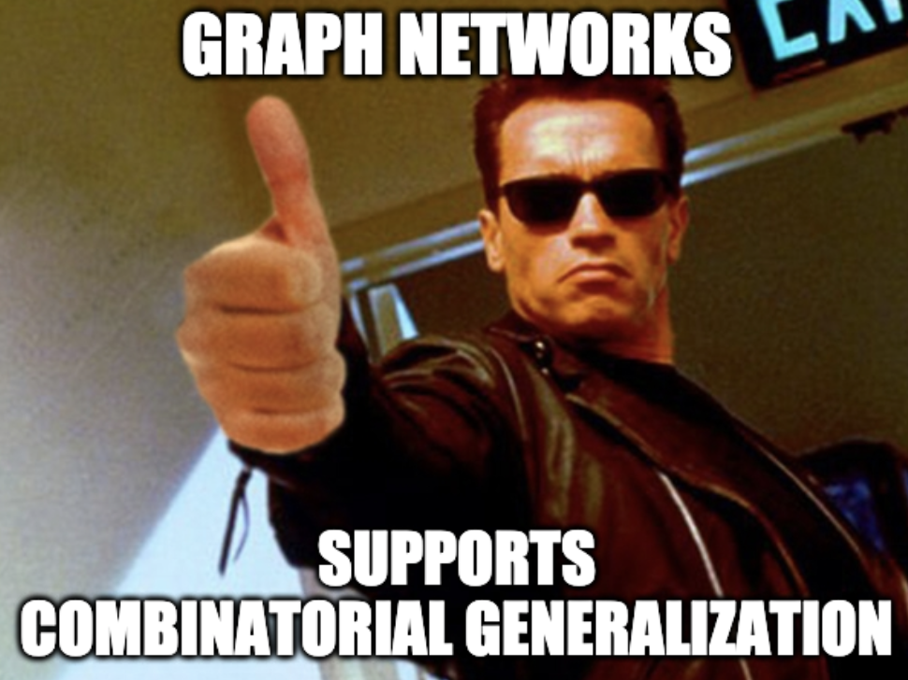
Summary
https://imgflip.com/memegenerator
Notes:
strong relational inductive biases

Slide 26
SECTION 5 Discussion

Slide 27
Limitations
Cannot discriminate specific non-isomorphic graph → Covariance to permutation of nodes & edges may needed
Notions like recursion, control flow, and conditional iteration are not straightforward to represent with graphs → require additional assumption

Slide 28
Open Questions
It is unclear the best ways to convert sensory data into more structured representations like graphs
How to deal with sparse-connected graph
Methods for adaptively modify the graph

Slide 29
Show me the code!
https://github.com/deepmind/graph_nets

